Slide 1

keylogger
Presented By :
Santhosh R
Anjalai Ammal Mahalingam Engineering College
Department Of Information Technology

Slide 2
Outline:
Problem Statement
Proposed System/Solution
System Development Approach (Technology Used)
Algorithm & Deployment
Result (Output Image)
Conclusion
Future Scope
References

Slide 3
Problem Statement
One of the significant concerns in today's digital age, where cybersecurity threats loom large, is the proliferation of key loggers. These stealthy software tools are designed to monitor and record keystrokes on a user's computer without their knowledge. Key loggers pose a severe threat to individuals and organizations as they can capture sensitive information such as passwords, credit card details, and other personal data, leading to identity theft, financial loss, and privacy breaches.

Slide 4
Proposed System/Solution
Real-time Monitoring:
SecureKey continuously monitors system processes and network activity in real-time to detect any suspicious behavior indicative of key logger activity.
Behavioral Analysis:
Utilizing machine learning algorithms, SecureKey analyzes user typing patterns and behavior to identify deviations that may signify the presence of a key logger.
Encrypted Keystrokes:
All keystrokes are encrypted at the kernel level before being transmitted, rendering them indecipherable to any potential key logger software.
Application Whitelisting:
SecureKey maintains a whitelist of trusted applications and blocks any unauthorized software attempting to log keystrokes, thus preventing key logger installation.
Regular Updates:
SecureKey receives regular updates to adapt to evolving threats and vulnerabilities, ensuring continued protection against the latest key logger techniques and tactics.

Slide 5
System Development Approach
Our system development approach for addressing the key logger threat involves iterative stages:
Analysis: Identifying user requirements and threat scenarios.
Design: Creating SecureKey's architecture and features, prioritizing security and usability.
Implementation: Developing SecureKey with encryption, anomaly detection, and real-time monitoring.
Testing: Conducting rigorous testing to ensure functionality and security effectiveness.
Deployment: Rolling out SecureKey with user-friendly interfaces and regular updates.
Maintenance: Continuously improving SecureKey based on user feedback and emerging threats. This agile approach ensures SecureKey remains effective and adaptive, providing comprehensive protection against key logger threats.

Slide 6
Algorithm
Import necessary libraries: tkinter for GUI, keyboard from pynput for capturing keyboard events, and json for handling JSON files.
Define global variables keys_used, flag, and keys.
Define functions:
generate_text_log(key): Write keystrokes to a text file.
generate_json_file(keys_used): Write keystrokes to a JSON file.
on_press(key): Callback function for key press events.
on_release(key): Callback function for key release events.
start_keylogger(): Start the keylogger and update GUI.
stop_keylogger(): Stop the keylogger and update GUI.
Create GUI elements: Labels and buttons for starting and stopping the keylogger.
Define the main event loop using Tkinter's mainloop() function.

Slide 7
Deployment Process
Ensure Python is installed on the target machine.
Install necessary libraries using pip:
pip install pynput
pip install jsonlib
Copy the Python script to the target machine.
Execute the script to start the keylogger.
Click "Start" button to begin keylogging.
Click "Stop" button to stop keylogging.

Slide 8
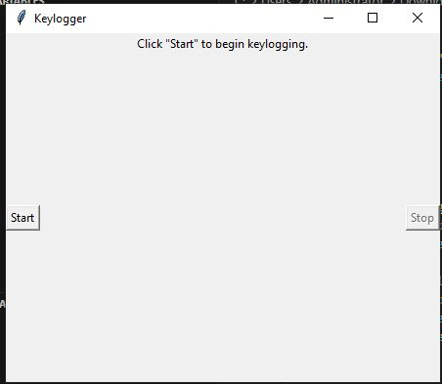
Result :

Slide 9
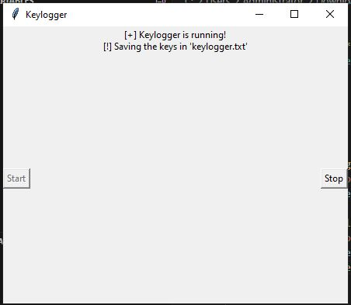
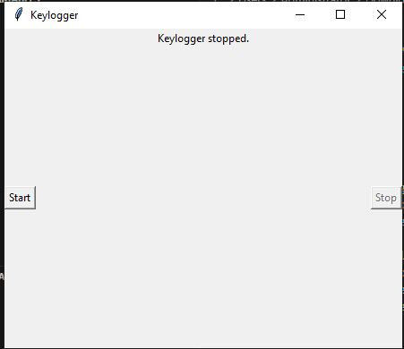

Slide 10
Conclusion
In conclusion, the developed keylogger project offers a basic yet functional implementation for capturing keyboard events. Through a combination of GUI elements and Python scripts, users can easily start and stop the keylogging process. The program efficiently logs key press, hold, and release events, storing the data both in a text file and a JSON format. However, it's essential to note that while this project serves educational purposes, the ethical implications of deploying such a tool must be considered carefully. Misuse of keyloggers can violate privacy rights and legal regulations. Therefore, users should exercise caution and adhere to ethical standards when deploying and using such software. Additionally, further enhancements could be made to improve the project's functionality and security, such as adding encryption for the logged data and implementing measures to prevent unauthorized access. Overall, this project provides a foundational understanding of keylogger development and serves as a basis for exploring more advanced concepts in cybersecurity and software development.

Slide 11
Future Scope
Enhanced Security Features: Implement encryption techniques to secure the logged keystrokes, ensuring that sensitive information remains protected from unauthorized access.
Remote Monitoring Capabilities: Integrate networking functionalities to allow remote monitoring and retrieval of logged keystrokes, enabling users to access the data from anywhere securely.
User Authentication: Implement user authentication mechanisms to restrict access to the keylogger application, ensuring that only authorized users can start or stop the keylogging process.
GUI Improvements: Enhance the graphical user interface (GUI) with more intuitive controls, visual indicators, and customizable settings to improve usability and user experience.
Logging Configuration: Allow users to configure logging settings, such as specifying which keys to monitor or excluding certain applications from logging, providing greater flexibility and customization options.
Integration with Security Suites: Integrate the keylogger project with comprehensive security suites or endpoint protection solutions to offer an all-in-one solution for safeguarding against various cyber threats.
Compliance with Regulations: Ensure compliance with relevant privacy regulations (e.g., GDPR, CCPA) by implementing features for data anonymization, consent management, and secure data handling practices.
Educational Resources: Develop educational resources and documentation to help users understand the ethical implications of keylogging and provide guidance on responsible usage and deployment practices.

Slide 12
References
Python Software Foundation. (n.d.). Python 3.9.7 Documentation. Retrieved from https://docs.python.org/3/index.html
Tkinter GUI Programming by Example: Learn to create modern GUIs using Tkinter by David Love, Packt Publishing, 2018.
Pynput Documentation. (n.d.). Retrieved from https://pynput.readthedocs.io/en/latest/index.html
JSON — JavaScript Object Notation. (n.d.). Retrieved from https://www.json.org/json-en.html

Slide 13
Thank You…

